Slide 1
ZeroVM enabled Content Based Access Control for Swift Storage
3rd Phase: Presenting Design Document
Presented by:
Prosunjit Biswas
Advisor: Dr. Ravi Sandhu &
Farhan Patwa
Presented at: Cloud & Big Data Lab, UTSA
Date: 29 August, 2014

Slide 2
Use case1 Alice is worried. Bob is accessing her object.
Alice has a data file ('data.json') stored in Swift. With Swift-ACL she can specify who can or cannot access the file, but she also want to define who can access how much content of the file. In other words, besides using ACL, she wants to specify access control on the content level of the file. So, she attaches a policy ('policy.json') with the file and wants that all the access request to the file would honor the policy associated with the file.
Synopsis : While Swift ACL is necessary, it is not sufficient.

Slide 3
Use case1 (continued)
We should help Alice.

Slide 4
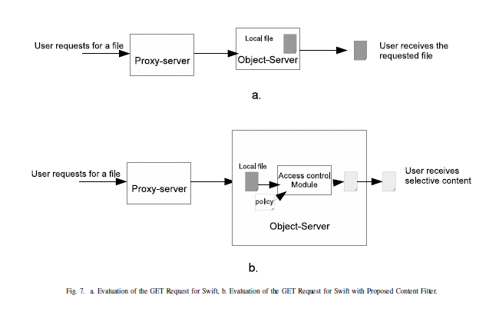
Use case1 (continued) How to help Alice

Slide 5
Use case2 Alice is worried. Bob’s application is accessing her object.
ZeroVM enables a user to run arbitrary application on Swift data located inside Swift storage by virtue of a ZeroVM Application. Bob wants to run a ZeroVM application with his own executable (A python script for example) on Alices protected data object ('data.json'). But this time Alice does not worry because she knows a ZeroVM developer is working on Swift Zerocloud midleware that would restrict any arbitrary access on her data object by ZeroVM application owned by other users.
Synopsis : ZeroVM application let allow arbitrary access of input file.
Once a file is allowed, no control on the content.

Slide 6
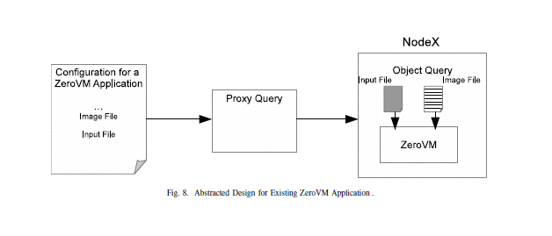
Use case2 (continued) Why Alice is worried?

Slide 7
Use case2 (continued)
We should help Alice.

Slide 8
Use case2 (continued) How to make Alice Happy.
We do not let the ZeroVM application directly manipulate the input object.
Application must mention beforehand, which part of the content it would access by specifying “queries”.
If the object’s policy allow a query, only query result is passed to the ZeroVM.
Original input object is not passed to the ZeroVM at all.

Slide 9
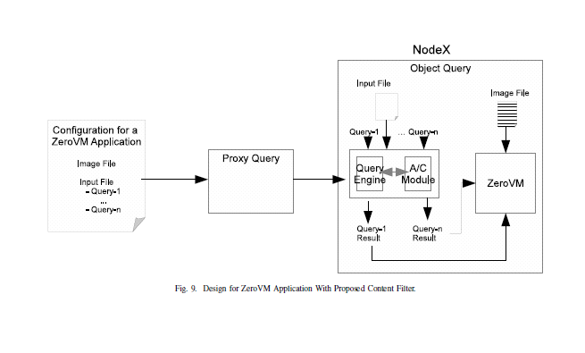
Use case2 (continued) Now Alice is Happy.

Slide 10
Use case2 (continued) Bob is too curious.
execution:
groups:
- name: "wordcount"
path: file://python:python
args: "wordcount.py"
devices:
- name: python
- name: stdout
- name: input
path: "swift://~/wordcount/text*.json"
queries:
-query1: /JSON/Path/1
-query2: /JSON/Path/2
bundling:
- "wordcount.py"
Wordcount.py
…
With open(“/dev/input/query1”)
…

Slide 11
Comparing uses cases:
Use case1:
Requester is possibly a User.
Object leaves Swift Storage.
Use case2:
Requester is a ZeroVM Application.
Object is processed arbitrarily inside Swift storage.

Slide 12

Now I feel safe. Thank you.

